Slide 1
2023-03-24

Slide 2
10.Bonus: Testing

Slide 3
Remember this slide...

Slide 4
Memo-ization
private static long fibonacciCache[] = new long[1000];
// Precondition: n >= 0 && n < 1000
public long fibonacci(long n) {
if (n == 0 || n == 1) {
// Base cases: fibo(0) = 0, fibo(1) = 1
return n;
} else if (fibonacciCache[n] != 0) {
return fibonacciCache[n];
} else {
// General case: fibo(n) = fibo(n-1) + fibo(n-2)
return fibonacciCache[n] = fibonacci(n-1) + fibonacci(n-2);
}
}

Slide 5
Memo-ization
private static long fibonacciCache[] = new long[1000];
// Precondition: n >= 0 && n < 1000
public long fibonacci(long n) {
if (n == 0 || n == 1) {
// Base cases: fibo(0) = 0, fibo(1) = 1
return n;
} else if (fibonacciCache[n] != 0) {
return fibonacciCache[n];
} else {
// General case: fibo(n) = fibo(n-1) + fibo(n-2)
return fibonacciCache[n] = fibonacci(n-1) + fibonacci(n-2);
}
}

Slide 6
Memo-ization
private static long fibonacciCache[] = new long[1000];
// Precondition: n >= 0 && n < 1000
public long fibonacci(long n) {
if (n == 0 || n == 1) {
// Base cases: fibo(0) = 0, fibo(1) = 1
return n;
} else if (fibonacciCache[n] != 0) {
return fibonacciCache[n];
} else {
// General case: fibo(n) = fibo(n-1) + fibo(n-2)
return fibonacciCache[n] = fibonacci(n-1) + fibonacci(n-2);
}
}

Slide 7
Memo-ization
private static long fibonacciCache[] = new long[1000];
// Precondition: n >= 0 && n < 1000
public long fibonacci(long n) {
if (n == 0 || n == 1) {
// Base cases: fibo(0) = 0, fibo(1) = 1
return n;
} else if (fibonacciCache[n] != 0) {
return fibonacciCache[n];
} else {
// General case: fibo(n) = fibo(n-1) + fibo(n-2)
return fibonacciCache[n] = fibonacci(n-1) + fibonacci(n-2);
}
}

Slide 8
Testing
During the development of a solution - either professionally, for a class project, or on the AP Exam - how do you verify your solution is correct?
Today we are going to take a look at the kinds of data sets you should test your solutions against
Then spend some time talking about how you can write code to test your code

Slide 9
printStatus
void printStatus(boolean isDone) { if (isDone) { System.out.println("Done!"); } else { System.out.println("Not Done!"); } } | Analysis
 | Test Sets

Slide 10
printStatus
void printStatus(boolean isDone) { if (isDone) { System.out.println("Done!"); } else { System.out.println("Not Done!"); } } | Analysis
 | isDone can be true or false
 | Test Sets

Slide 11
printStatus
void printStatus(boolean isDone) { if (isDone) { System.out.println("Done!"); } else { System.out.println("Not Done!"); } } | Analysis
 | isDone can be true or false
 | Test Sets
 | true false

Slide 12
calcFoodAmount
int calcFoodAmount(int age) { if (age < 3) { return 1; } if (age < 6) { return 3; } if (age < 10) { return 5; } return 10; } | Analysis
 | Test Sets

Slide 13
calcFoodAmount
int calcFoodAmount(int age) { if (age < 3) { return 1; } if (age < 6) { return 3; } if (age < 10) { return 5; } return 10; } | Analysis
 | age could be negative, zero, or positive < is used for comparison evaluation: Are there any conditions where <= need special-casing
 | Test Sets

Slide 14
calcFoodAmount
int calcFoodAmount(int age) { if (age < 3) { return 1; } if (age < 6) { return 3; } if (age < 10) { return 5; } return 10; } | Analysis
 | age could be negative, zero, or positive < is used for comparison evaluation: Are there any conditions where <= need special-casing
 | Test Sets
 | -1, 0, 1 3 6 10

Slide 15
reverseString
String reverseString(String s) { String result = ""; for (int i = s.length() - 1; i >= 0; i--) { result += s.charAt(i); } return result; } | Analysis
 | Test Sets

Slide 16
reverseString
String reverseString(String s) { String result = ""; for (int i = s.length() - 1; i >= 0; i--) { result += s.charAt(i); } return result; } | Analysis
 | s could be null (probably okay to skip) s could be empty i is used as an index into s: Are there any conditions by which (i < 0) or (i > s.length-1)
 | Test Sets

Slide 17
reverseString
String reverseString(String s) { String result = ""; for (int i = s.length() - 1; i >= 0; i--) { result += s.charAt(i); } return result; } | Analysis
 | s could be null (probably okay to skip) s could be empty i is used as an index into s: Are there any conditions by which (i < 0) or (i > s.length-1)
 | Test Sets
 | "" "test"

Slide 18
findMinValue
int findMinValue(int[] array) { int minValue = array[0]; for (int i = 1, n = array.length; i < n; i++) { if (array[i] < minValue) { minValue = array[i]; } } return minValue; } | Analysis
 | Test Sets

Slide 19
findMinValue
int findMinValue(int[] array) { int minValue = array[0]; for (int i = 1, n = array.length; i < n; i++) { if (array[i] < minValue) { minValue = array[i]; } } return minValue; } | Analysis
 | array could be null (probably okay to skip) array cannot be empty i is used as an index into array: Are there any conditions by which (i < 0) or (i > array.length-1) < is used for comparison evaluation: Are there any conditions where <= needs special-casing
 | Test Sets

Slide 20
findMinValue
int findMinValue(int[] array) { int minValue = array[0]; for (int i = 1, n = array.length; i < n; i++) { if (array[i] < minValue) { minValue = array[i]; } } return minValue; } | Analysis
 | array could be null (probably okay to skip) array cannot be empty i is used as an index into array: Are there any conditions by which (i < 0) or (i > array.length-1) < is used for comparison evaluation: Are there any conditions where <= needs special-casing
 | Test Sets
 | [1] [1,2] [2,1] [1,1]

Slide 21
hasDuplicates
boolean hasDuplicates(int[] values) { int n = values.length; for (int i = 0; i < n; i++) { for (int j = i + 1; j < n; j++) { if (values[i] == values[j]) { return true; } } } return false; } | Analysis
 | Test Sets

Slide 22
hasDuplicates
boolean hasDuplicates(int[] values) { int n = values.length; for (int i = 0; i < n; i++) { for (int j = i + 1; j < n; j++) { if (values[i] == values[j]) { return true; } } } return false; } | Analysis
 | values could be null (probably okay to skip) values can be empty i and j are both used as indexes into values: Are there any conditions by which (i|j < 0) or (i|j > values.length-1)
 | Test Sets

Slide 23
hasDuplicates
boolean hasDuplicates(int[] values) { int n = values.length; for (int i = 0; i < n; i++) { for (int j = i + 1; j < n; j++) { if (values[i] == values[j]) { return true; } } } return false; } | Analysis
 | values could be null (probably okay to skip) values can be empty i and j are both used as indexes into values: Are there any conditions by which (i|j < 0) or (i|j > values.length-1)
 | Test Sets
 | null, [], [1] [1,2], [1,1] [1,2,1]

Slide 24
binarySearch
private int binarySearch( ArrayList<String> words, String targetWord) { int lowIdx = 0; int highIdx = words.size() - 1; while (lowIdx <= highIdx) { int midIdx = ((highIdx - lowIdx) / 2) + lowIdx; int middleCompareResult = words.get(midIdx).compareTo(targetWord); if (middleCompareResult == 0) { return midIdx; } else if (middleCompareResult > 0) { highIdx = midIdx - 1; } else { lowIdx = midIdx + 1; } } return -1; } | Analysis

Slide 25
binarySearch
private int binarySearch( ArrayList<String> words, String targetWord) { int lowIdx = 0; int highIdx = words.size() - 1; while (lowIdx <= highIdx) { int midIdx = ((highIdx - lowIdx) / 2) + lowIdx; int middleCompareResult = words.get(midIdx).compareTo(targetWord); if (middleCompareResult == 0) { return midIdx; } else if (middleCompareResult > 0) { highIdx = midIdx - 1; } else { lowIdx = midIdx + 1; } } return -1; } | Analysis
 | words/targetWord could be null (probably okay to skip) words can be empty midIdx is used as an index into words: Are there any conditions by which (midIdx < 0) or (midIdx > words.length-1) int division is used to calculate midIdx: Are there any conditions where rounding results in unexpected results

Slide 26
binarySearch
private int binarySearch( ArrayList<String> words, String targetWord) { int lowIdx = 0; int highIdx = words.size() - 1; while (lowIdx <= highIdx) { int midIdx = ((highIdx - lowIdx) / 2) + lowIdx; int middleCompareResult = words.get(midIdx).compareTo(targetWord); if (middleCompareResult == 0) { return midIdx; } else if (middleCompareResult > 0) { highIdx = midIdx - 1; } else { lowIdx = midIdx + 1; } } return -1; } | Analysis
 | words/targetWord could be null (probably okay to skip) words can be empty midIdx is used as an index into words: Are there any conditions by which (midIdx < 0) or (midIdx > words.length-1) int division is used to calculate midId: Are there any conditions where rounding results in unexpected results
Test Sets
([],""), ([],"fig"), (["fig"],"fig"), (["date"],"fig"), (["fig","pear"],"fig"), (["pear","fig"],"fig"), (["pear","kiwi", "fig"],"fig"), (["pear","kiwi", "date"],"fig")

Slide 27
Automated Testing
Automated Testing is a fancy way of saying that you have code that tests your code
The de-facto standard for how most software testing is currently performed
Reduced costs, increased scale, and continuous delivery
"We only want to fix something one time"
This differs from Manual Testing where a human is manually interacting with your system (e.g. using the mouse or keyboard)
Typically done in conjunction with a Test Plan (document explaining the manual actions to take and the expected results)
Error-prone, expensive, and difficult to scale as your code grows
Still required for some platforms or solutions

Slide 28
Types of Automated Testing
Test Driven Development (TDD)
As we discussed in Unit 3.2 - TDD is a popular development technique where you write the tests before your code - when the tests pass you're done!
A good hedge for groups where there is resistance to test writing
Can also help with the documentation effort
Unit Testing
Tests are written alongside the code and verify at the class or method level
These typically test the public surface of classes and objects; To enforce their "contract" with the other components of the system
We have been using unit tests in a number of our exercises
A popular Java Unit Test framework is JUnit (more on that in a couple of slides)
UI or Browser Testing
Test code mimics user interactions by sending mouse and keyboard events
Can be done "headless" - without the UI appearing on screen
Often makes use of APIs built to support assistive technologies

Slide 29
Types of Automated Testing
API Testing
If your product offers a public API this testing makes sure the contracts don't ever break in an unexpected way.
Often simulate how API payloads are constructed and how APIs are versionsed
Often also have built-in capabiilties to easily support things like slow or intermittent connections and authentication and security
Code Coverage
Systems that "instrument" code and test code to tell you how effective your tests are - e.g. which lines are exercised and which code branches are taken
If code coverage indicates that an object has no test coverage - then your confidence in making changes to the system can be reduced
Tests the Tests

Slide 30
Unit Testing with JUnit
class MyTestArea { @Test void firstTest() { assertEquals(expected, got) } @Test void secondTest() { assertTrue(got) } }

Slide 31
Unit Testing with JUnit
class MyTestArea { @Test void firstTest() { assertEquals(expected, got) } @Test void secondTest() { assertTrue(got) } }
A JUnit Test Class contains one or more related Tests - A JUnit Test Suite consists of many JUnit Test Classes

Slide 32
Unit Testing with JUnit
class MyTestArea { @Test void firstTest() { assertEquals(expected, got) } @Test void secondTest() { assertTrue(got) } }
A JUnit Test Class contains one or more related Tests - A JUnit Test Suite consists of many JUnit Test Classes
Each Test is an instance method of the JUnit Test Class and has the @Test annotation

Slide 33
Unit Testing with JUnit
class MyTestArea { @Test void firstTest() { assertEquals(expected, got) } @Test void secondTest() { assertTrue(got) } }
A JUnit Test Class contains one or more related Tests - A JUnit Test Suite consists of many JUnit Test Classes
Each Test is a public instance method of the JUnit Test Class and has the @Test annotation
Each Test uses assertion statements to test for expected outcomes

Slide 34
Unit Testing with JUnit
class MyTestArea { @Test void firstTest() { assertEquals(expected, got) } @Test void secondTest() { assertTrue(got) } }
A JUnit Test Class contains one or more related Tests - A JUnit Test Suite consists of many JUnit Test Classes
Each Test is a public instance method of the JUnit Test Class and has the @Test annotation
Each Test uses assertion statements to test for expected outcomes
JUnit Test Classes are regular Java classes and adhere to all the normal rules about what they can and cannot access.
This means that generally JUnit Test Classes test the public surface - "the contract" with the rest of the system - and does not have access to the private internals.

Slide 35
Unit Testing with JUnit
class Student { private String name; public Student() { } public Student(String name) { this.name = name; } public String getName() { return name; } }

Slide 36
Unit Testing with JUnit
class StudentTest { @Test void emptyConstruction() { Student s = new Student(); assertEquals(null, s.getName()) } @Test void goodConstruction() { Student s = new Student("Chris"); assertEquals("Chris", s.getName()) } }
class Student { private String name; public Student() { } public Student(String name) { this.name = name; } public String getName() { return name; } }

Slide 37
Unit Testing with JUnit
class StudentTest { @Test void emptyConstruction() { Student s = new Student(); assertEquals(null, s.getName()) } @Test void goodConstruction() { Student s = new Student("Chris"); assertEquals("Chris", s.getName()) } }
class Student { private String name; public Student() { } public void Student(String name) { this.name = name; } public String getName() { return name; } }

Slide 38
Unit Testing with JUnit
class StudentTest { @Test void emptyConstruction() { Student s = new Student(); assertEquals(null, s.getName()) } @Test void goodConstruction() { Student s = new Student("Chris"); assertEquals("Chris", s.getName()) } }
class Student { private String name; public Student() { } public Student(String name) { this.name = name; } public String getName() { return name; } }

Slide 39
Unit Testing with JUnit
JUnit has LOTS more functionality to explore
Setup and Teardown
@BeforeAll - A static method run before any Test in a Test Class
@BeforeEach - An instance method run every Test in a Test Class
@AfterEach - An instance method run after every Test in a Test Class
@AfterAll - A static method run after the last Test in a Test Class
Assertions
assertEquals / assertNotEquals
assertTrue / assertFalse / assertNull
assertArrayEquals
assertInstanceOf / assertThrows

Slide 40
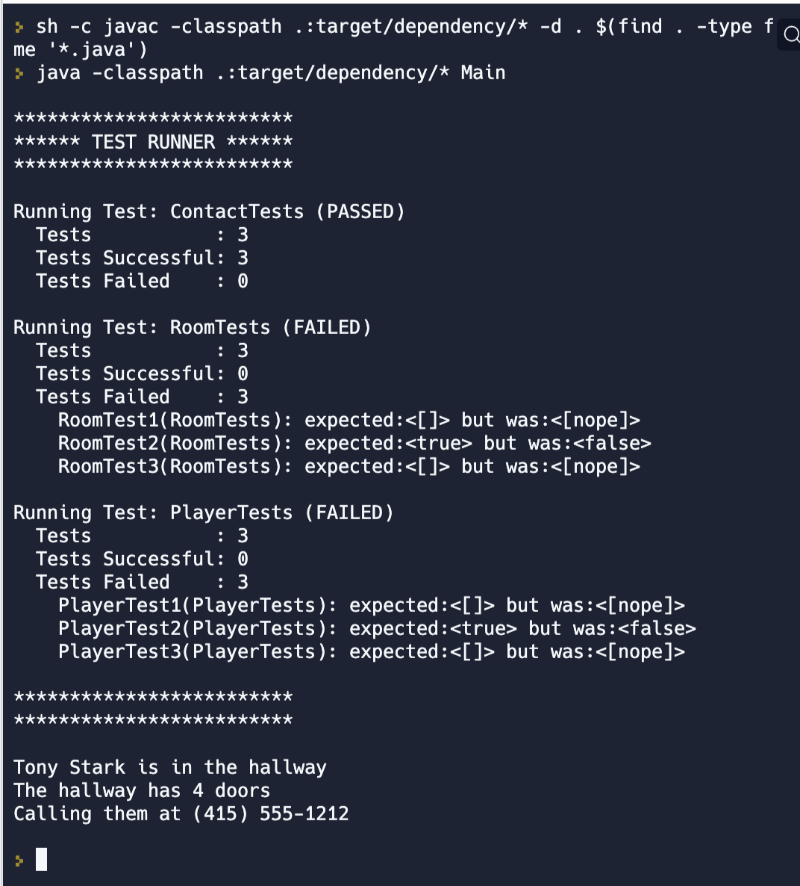
Practice on your own
Replit built-in support for JUnit is not awesome
Replit - Unit Testing
Basic program with three classes we have seen before: Room, Contact, and Player
Tests have been provided for Contact - Add tests for the other two objects
References
Support for Unit Testing in Replit
JUnit References
User Guide
Writing Tests

